Slide 1

Community
Delia Casa,
Frances Coronel,
Chumeng Xu

Slide 2

“
How might we
create a safe place for people of all backgrounds to discuss important local, national, and global issues?
”

Slide 3
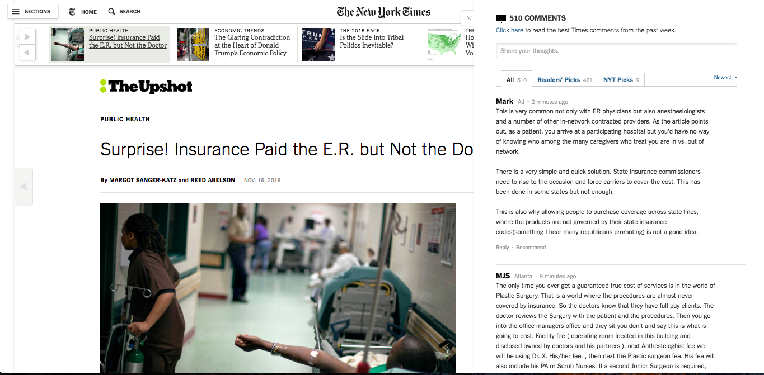

Slide 4


Notes:
Need to change

Slide 5
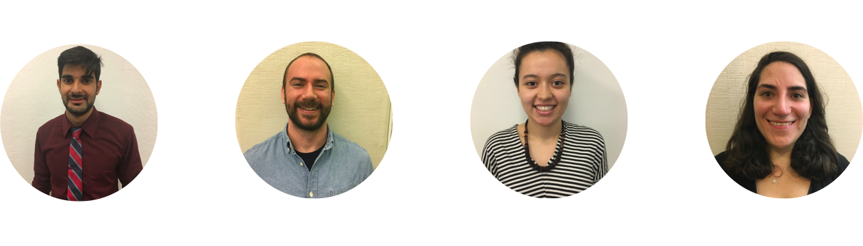

User Findings
“Nothing informative to contribute.”
“My comments are not seen or valued.”
“I don’t care about the issue.”
Notes:
Change to the final version

Slide 6

Name: Ana
Age: 28
Location: Alexandria, VA
Occupation: Graphic designer

Slide 7
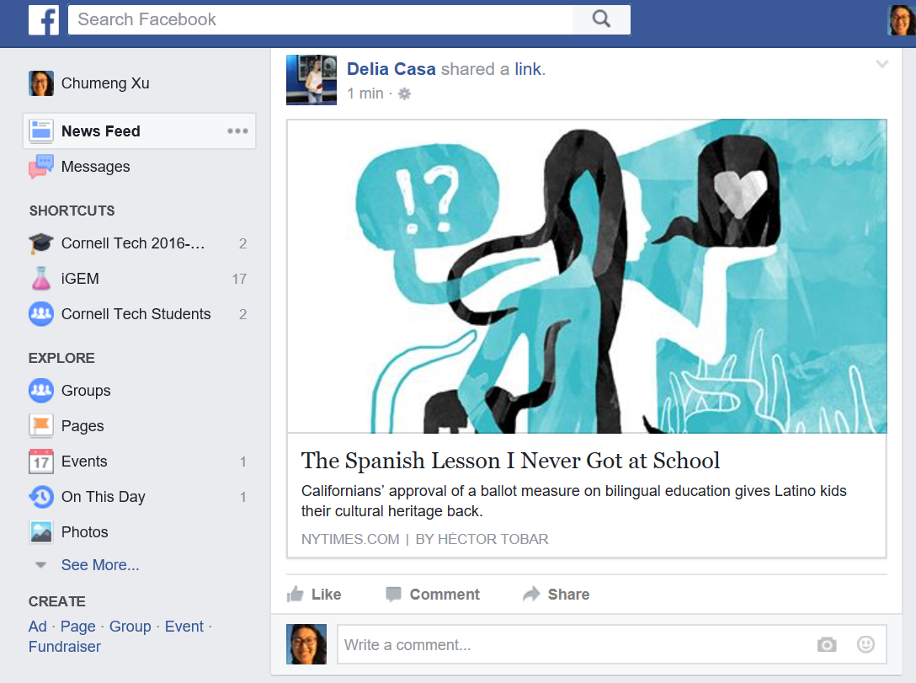



Ana García

Slide 8
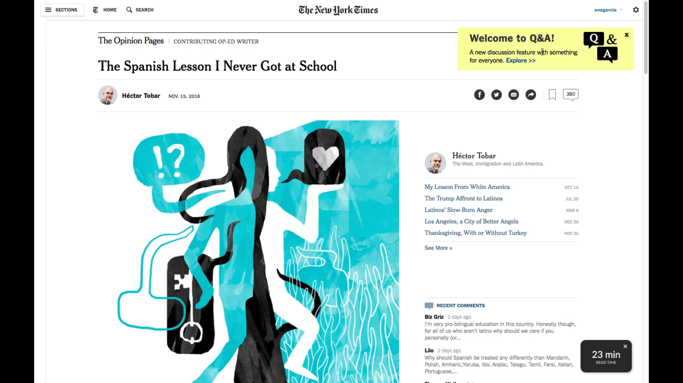

Slide 9
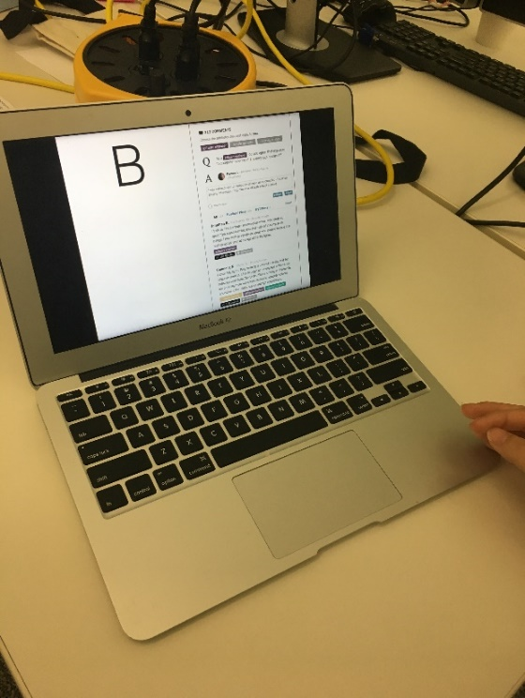

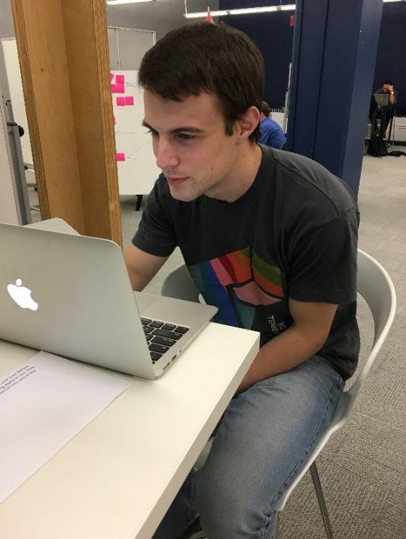
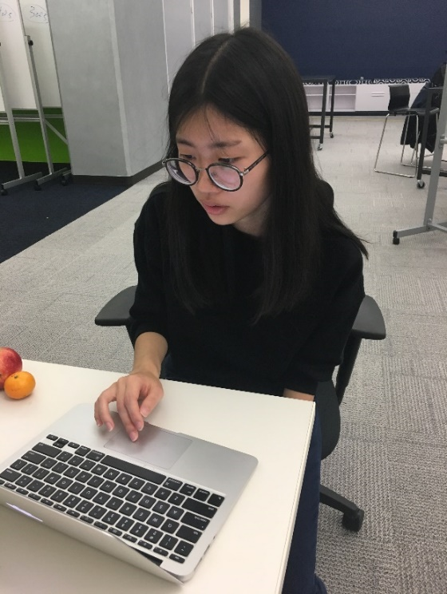
Validation!
90% said they were more likely to read the comments.
80% said they were more likely to comment.
100% said they were more likely to do one or the other.
“[Q&A] had a lot more context, so you knew what the comments were on.”

Slide 10
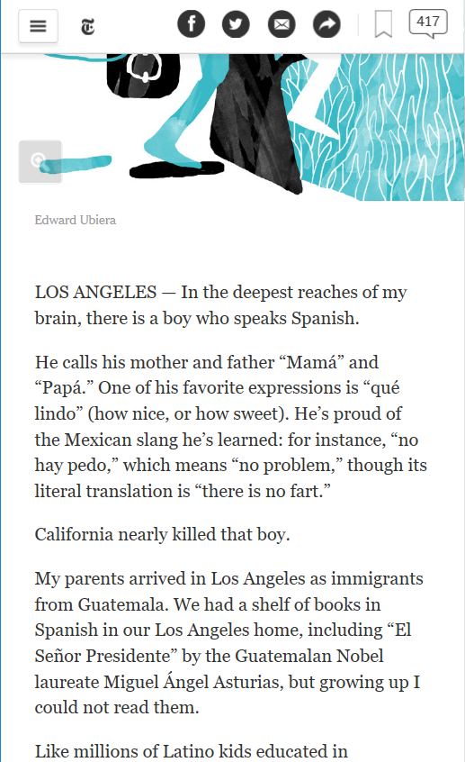




Writer customized tag
Language
Experts
Auto-generated tag
Children of Immigrants
First-generation Latino
IBM Watson
Alchemy API
Teachers
Readers customized tag
Spanish-speaking
Parents

Slide 11
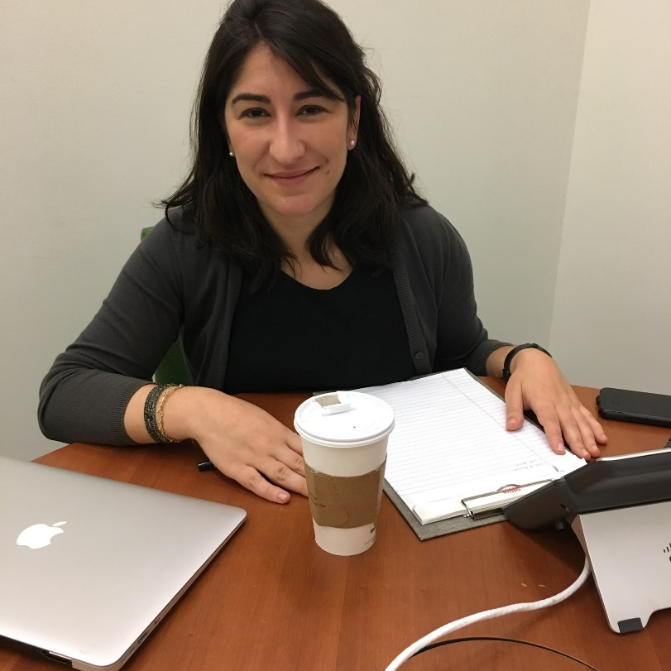
"I don't [think it would be difficult to incorporate] at all… It's a great opportunity, even if it takes more time."
— Rebecca Ruiz, the New York Times Reporter
Notes:
Change the quote

Slide 12

Key Wedge
The highest-quality journalism
The most informative user-generated content

Slide 13

Key Wedge Subtly collect information about users for better question, article, ad, and social media targeting.

Slide 14







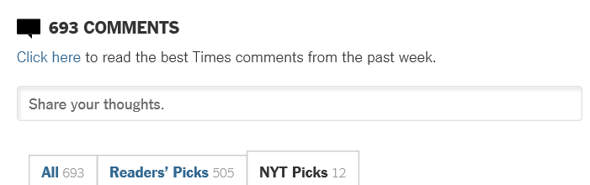

Editor
The NYT Content Management System
IBM Watson
Alchemy API
User Attribute
Database
Extract key concepts/entities from article
Self Identify attributes by selecting question to answer
Prompt user to comment with targeting questions
The NYT commenting platform
Reader
Notes:
What did we code

Slide 15
78.5 million non-subscribing visitors to nytimes.com each month
TAM
SAM
Target
15.7 million users who get questions related to them in Q&A
30,000 new digital subscribers
=
$2,700,000/year in revenue

Slide 16
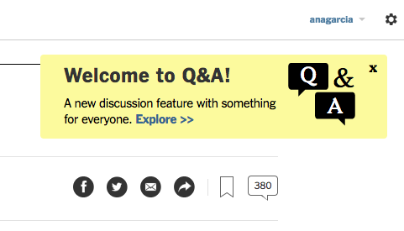
Go-to Market Strategy
Pop-ups on web and mobile.
Coordinate social media posts for launch date.
Create press release on website that explains the new feature, with an infographic on how it works / why it was made.
Email notifications.
Notes:
Market strategy

Slide 17

Key Learnings from Our Journey
User research is key.
NYT readers want to learn from and inform each other.
Engagement is crucial to the future of news platforms.

Slide 18

What’s next?
Provide all of our code and assets to the New York Times community team.
Provide relevant documentation (code annotation, design, user research log, possible extensions, etc.).
Hand off IP.
Check out Q&A at:
http://bit.ly/nyt-qa

